Slide 1

Getting started
with Whispli
GUIDE
2024 Redesign - Case Manager’s Journey Guide
Tutorials on how to handle a Report through Whispli as an admin

Slide 2
Whispli Case Manager Guide
Welcome to Whispli!
Whispli is a trusted and independent tool enabling your collaborators to submit reports and share misconduct within your Organization.
Using Whispli, you can receive, handle and investigate all reports in a simple and effective way.
We know you may still have questions, so please reach out to us if anything is not clear.
💡Before you start, you might be wondering
Ready to start exploring Whispli? This Case Manager Guide will help you learn all you need to know to handle a report and help keep your organization compliant.
Need more help? Check out our ❓Helpcenter with our FAQ.
How can I handle a report through the Whispli platform?

Slide 3
Content
How to handle a case in one single page
Access the details of the report | Submit the workflow
How to create a dashboard
Filter data | Configure your analytics
How to share a single report with a guest user
With a member(s) | With someone outside of Whispli
How to filter your reports
Have an efficient visibility of the reports | Find easily a report
What type of notifications the informant receives in their anonymous inbox
When you take action on their report
How to extract data
From reports/workflows | From one single report/workflow
How to access and filter your audit trail
Have an overview of the activities realized in your Whispli account
How to use the internal form
Use the internal form feature | Centralize your reports in the Whispli platform
How to update your hyperlink
Update your hyperlink(s) in the description field | Create new tabs

Slide 4
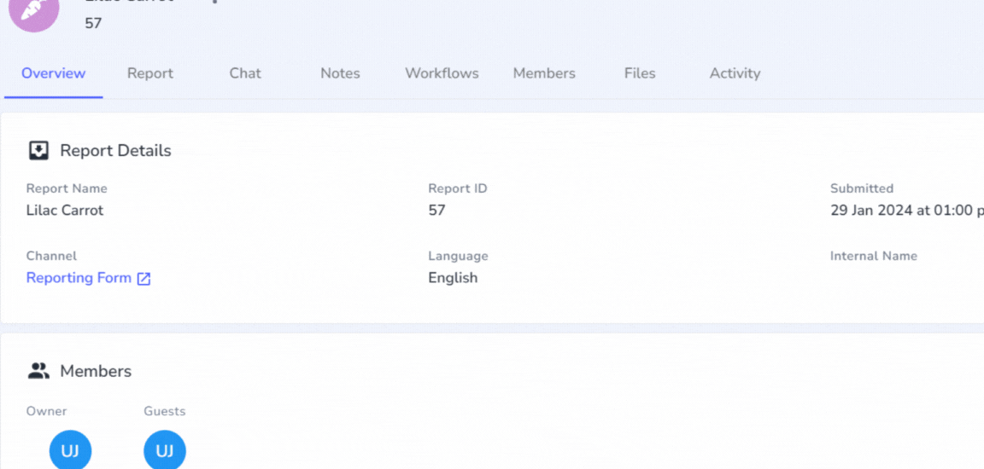
How to handle a case in one single page
How to handle a case in one single page
How to create a dashboard
How to share a single report with a guest user
How to filter your reports
What type of notifications the informant receives in their anonymous inbox
How to extract data
How to access and filter your audit trail
How to use the internal form
How to update your hyperlink
Work on a case in one single page
Learn how to access the details of a report and investigate through a workflow.
❓FAQs
Watch tutorial
How can i use Workflows to save internal notes, documents, case files, etc?
Can i submit multiple Workflows on a Report ?
What is each component of a report?

Slide 5
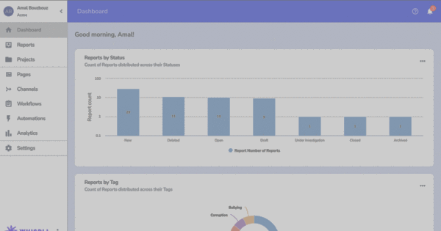
How to create a dashboard
How to handle a case in one single page
How to create a dashboard
How to share a single report with a guest user
How to filter your reports
What type of notifications the informant receives in their anonymous inbox
How to extract data
How to access and filter your audit trail
How to use the internal form
How to update your hyperlink
Configure your analytics and create a dashboard
Learn how to filter data to get an efficient visibility on your dashboard
❓FAQs
Watch tutorial
My Whispli Dashboard

Slide 6
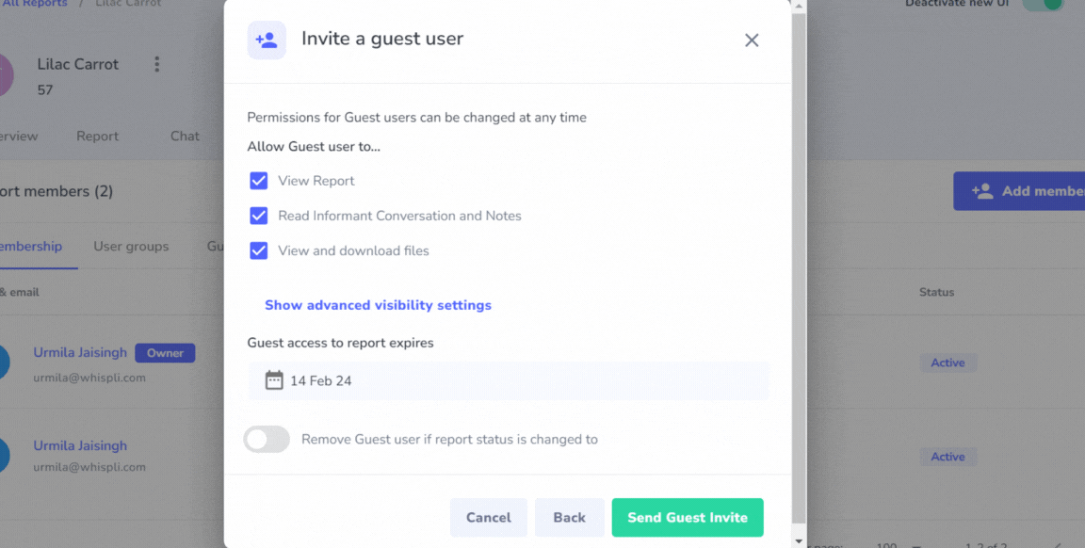
How to share a single report with a guest user
How to handle a case in one single page
How to create a dashboard
How to share a single report with a guest user
How to filter your reports
What type of notifications the informant receives in their anonymous inbox
How to extract data
How to access and filter your audit trail
How to use the internal form
How to update your hyperlink
Share a report with someone outside of Whispli
Learn how to share a report with someone outside of Whispli.
❓FAQs
How to share a single Report?
Watch tutorial

Slide 7
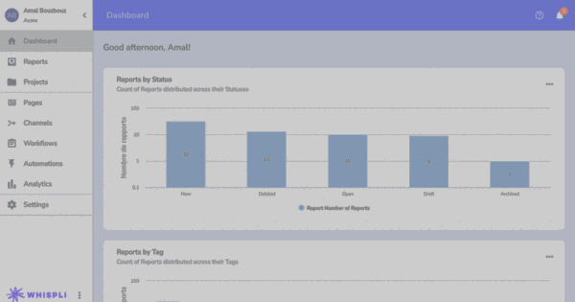
How to filter your reports
How to handle a case in one single page
How to create a dashboard
How to share a single report with a guest user
How to filter your reports
What type of notifications the informant receives in their anonymous inbox
How to extract data
How to access and filter your audit trail
How to use the internal form
How to update your hyperlink
Make sure to get efficient visibility of reports
Learn how to filter reports in the Reports tab in order to find them easily.
❓FAQs
How can i view all my assigned Reports?
Watch tutorial

Slide 8
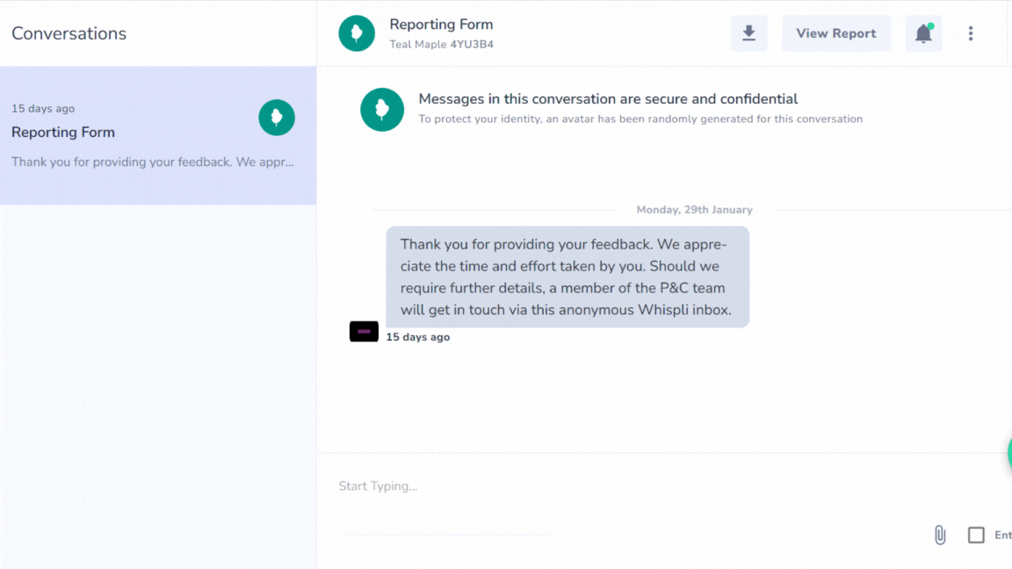
What type of notifications the informant receives
How to handle a case in one single page
How to create a dashboard
How to share a single report with a guest user
How to filter your reports
What type of notifications the informant receives in their anonymous inbox
How to extract data
How to access and filter your audit trail
How to use the internal form
How to update your hyperlink
Learn what types of notifications the informant receives in their Whispli safe inbox
Watch tutorial

Slide 9
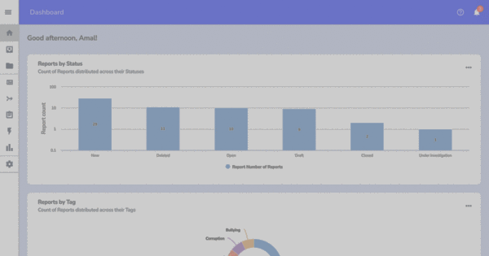
How to extract data
How to handle a case in one single page
How to create a dashboard
How to share a single report with a guest user
How to filter your reports
What type of notifications the informant receives in their anonymous inbox
How to extract data
How to access and filter your audit trail
How to use the internal form
How to update your hyperlink
Export data from your account to external uses
Learn how to export reports and/or workflows from your Whispli account
❓FAQs
Can I export all Reports data and/or all Workflow Submissions?
Watch tutorial

Slide 10
How to access and filter your audit trail
How to handle a case in one single page
How to create a dashboard
How to share a single report with a guest user
How to filter your reports
What type of notifications the informant receives in their anonymous inbox
How to extract data
How to access and filter your audit trail
How to use the internal form
How to update your hyperlink
Filter your audit trail and get efficient visibility of what is going on in your account
Learn how to filter your audit trail to track every activity realized in your account
Watch tutorial
❓FAQs
What is the "Audit Trail" feature?

Slide 11
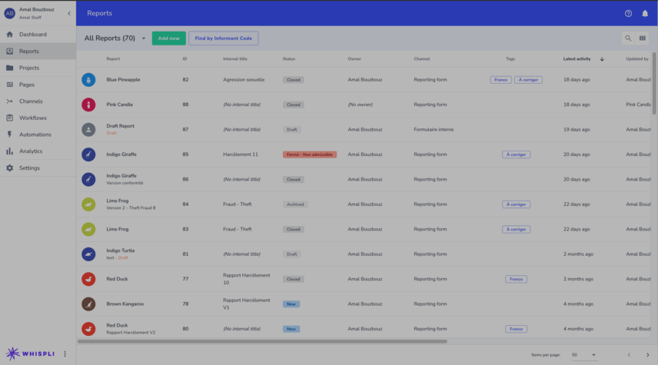
How to use the internal form
How to handle a case in one single page
How to create a dashboard
How to share a single report with a guest user
How to filter your reports
What type of notifications the informant receives in their anonymous inbox
How to extract data
How to access and filter your audit trail
How to use the internal form
How to update your hyperlink
Use the internal form feature and centralize all your reports in the Whispli platform
Watch tutorial
❓FAQs
What is the "Audit Trail" feature?

Slide 12
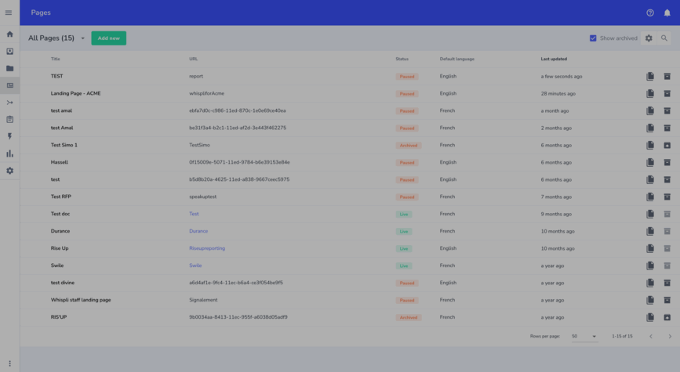
How to update your hyperlink
How to handle a case in one single page
How to create a dashboard
How to share a single report with a guest user
How to filter your reports
What type of notifications the informant receives in their anonymous inbox
How to extract data
How to access and filter your audit trail
How to use the internal form
How to update your hyperlink
Learn how to update your hyperlink in the description field.
Watch tutorial
❓FAQs
Creating/Editing a landing page

