Slide 1

Getting started
with Whispli
GUIDE
2024 Redesign - Case Manager’s Journey Guide
Tutorials on how to handle a Report through Whispli as a member

Slide 2
Whispli Case Manager Guide
Welcome to Whispli!
Whispli is a trusted and independent tool enabling your collaborators to submit reports and share misconduct within your Organization.
Using Whispli, you can receive, handle and investigate all reports in a simple and effective way.
We know you may still have questions, so please reach out to us if anything is not clear.
💡Before you start, you might be wondering
Ready to start exploring Whispli? This Case Manager Guide will help you learn all you need to know to handle a report and help keep your organization compliant.
Need more help? Check out our ❓Helpcenter with our FAQ.
How can I handle a report through the Whispli platform?

Slide 3
Content
How to see your dashboards
By default | In the analytics tab
How to access your settings
Change the language of the interface | Edit other settings
How to handle a case in one single page
Access the details of the report | Submit the workflow
How to filter reports in your Reports tab
Have an efficient visibility of the reports | Find easily a report
How to share a single report with a guest user
With a member(s) | With someone outside of Whispli
How to create a new version of a report
Choose the details remaining in the new version | Share it with a member(s)
How to archive and redact a report
Close the report and archive it | Redact the report to anonymise

Slide 4
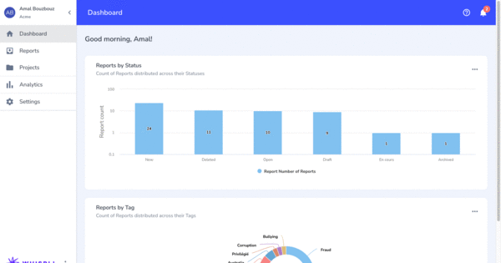
How to use your dashboards
How to see your dashboard
How to access your settings
How to handle a case in one page
How to filter reports in your Reports tab
How to share a single report with a guest user
How to create a new version of a report
How to archive and redact a report
Welcome to your Dashboard
Learn how to use your default dashboard, share dashboards and receive dashboards.
❓FAQs
My Whispli Dashboard
Watch tutorial

Slide 5
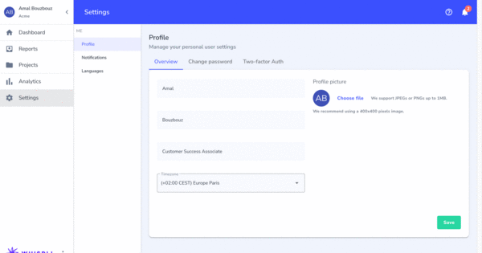
How to access your settings
How to see your dashboard
How to access your settings
How to handle a case in one page
How to filter reports in your Reports tab
How to share a single report with a guest user
How to create a new version of a report
How to archive and redact a report
Change the settings of your platform
Learn how to change the language of your interface and edit other settings.
❓FAQs
How can i change my Profile Settings ?
How can i change my Password ?
Watch tutorial

Slide 6
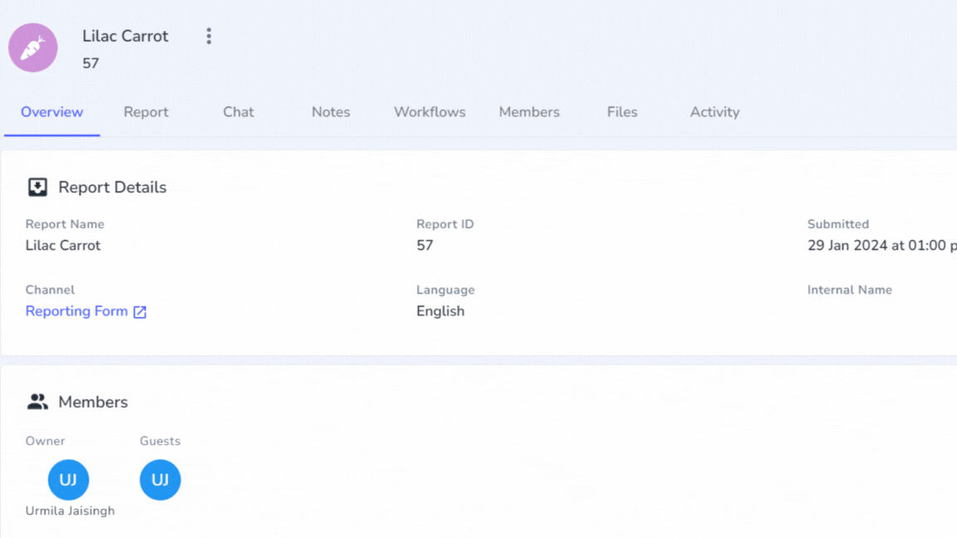
How to handle a case in one single page
How to see your dashboard
How to access your settings
How to handle a case in one page
How to filter reports in your Reports tab
How to share a single report with a guest user
How to create a new version of a report
How to archive and redact a report
Work on a case in one single page
Learn how to access the details of a report and investigate through a workflow.
❓FAQs
How can i use Workflows to save internal notes, documents, case files, etc?
Can i submit multiple Workflows on a Report ?
What is each component of a report?
Watch tutorial

Slide 7
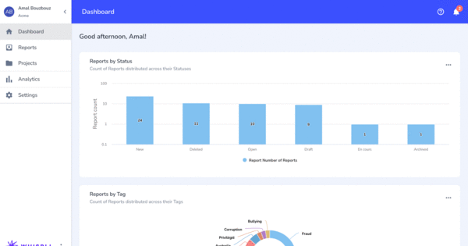
How to filter reports
How to see your dashboard
How to access your settings
How to handle a case in one page
How to filter reports in your Reports tab
How to share a single report with a guest user
How to create a new version of a report
How to archive and redact a report
Make sure to get efficient visibility of reports
Learn how to filter the reports in the Reports tab in order to find them easily.
❓FAQs
How can i view all my assigned Reports?
Watch tutorial

Slide 8
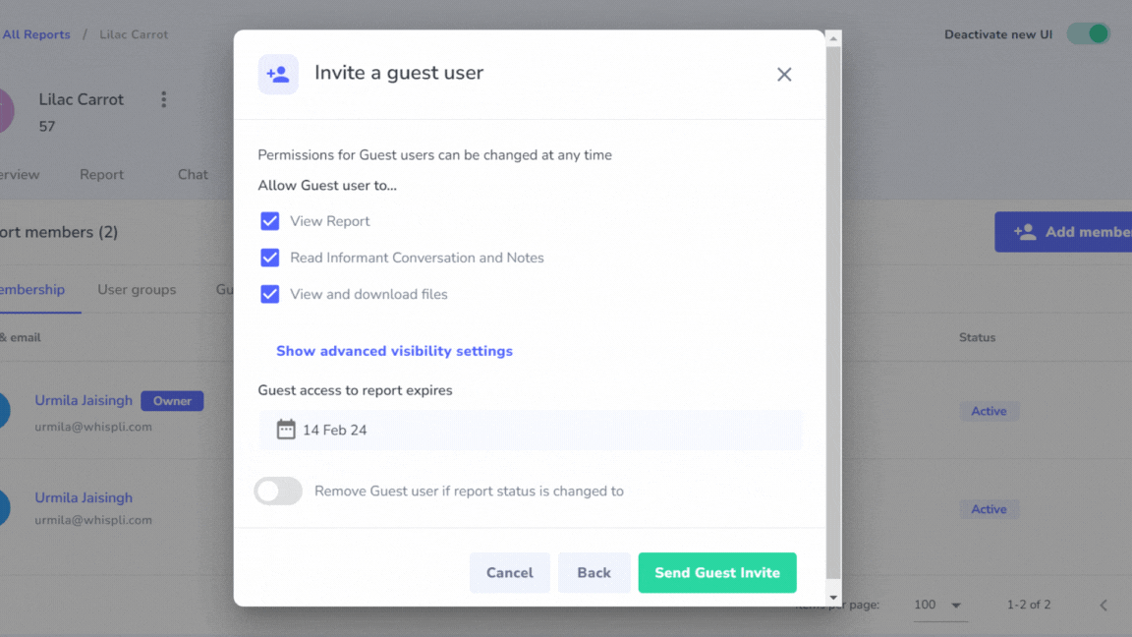
How to share a single report with a guest user
How to see your dashboard
How to access your settings
How to handle a case in one page
How to filter reports in your Reports tab
How to share a single report with a guest user
How to create a new version of a report
How to archive and redact a report
Share a report to with someone outside Whispli
Learn how to share a report with someone outside of Whispli.
❓FAQs
How to share a single Report?
Watch tutorial
Watch tutorial

Slide 9
How to create a new version of a report
How to see your dashboard
How to access your settings
How to handle a case in one page
How to filter reports in your Reports tab
How to share a single report with a guest user
How to create a new version of a report
How to archive and redact a report
Create a new version of a report in order to share selected information
Learn how to duplicate a report and select information in the new version of a report.
Watch tutorial
❓FAQs
What is a Version of report?

Slide 10
How to archive and redact a report
How to see your dashboard
How to access your settings
How to handle a case in one page
How to filter reports in your Reports tab
How to share a single report with a guest user
How to create a new version of a report
How to archive and redact a report
Close and archive a report
Learn how to archive a closed report by setting a retention policy, then redact it if needed in order to anonymise report details.
Watch tutorial
❓FAQs
Report Redaction
What is the “Data Retention Policy” feature?

